Slide 1

The Gaming Data Opportunity
Platforms, Live Streaming, and Beyond

Slide 2
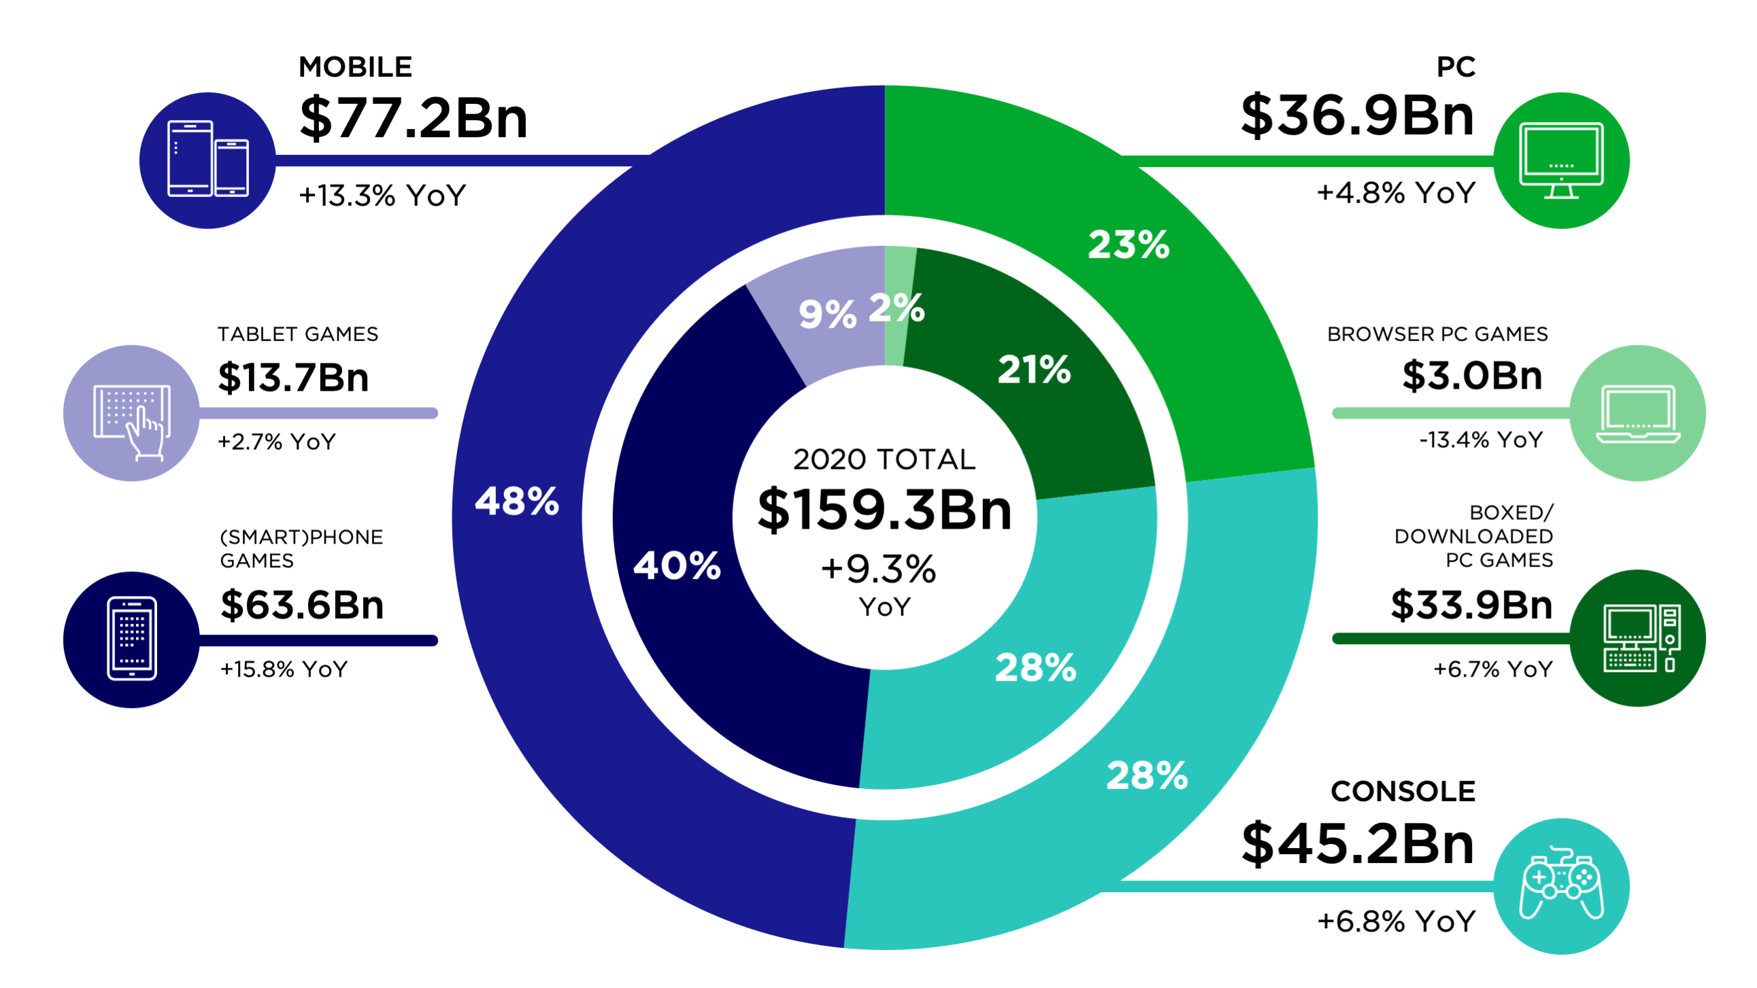
Gaming is a $159B Global Industry

Slide 3
Covid is Accelerating the Gaming Industry
Nintendo’s hardware demand skyrockets; flagship game Animal Crossing: New Horizons hit its 5 year sales goal in under 6 months, selling 23M copies.
Nvidia gaming hardware flies off shelves; suppliers can’t keep up with demand.
Indie game darling Fall Guys recently sold 1.5M copies in a single day, peaking at 120k concurrent users across PC and PlayStation 4.
Twitch saw hours watched jump 50% between March and April and a full 101% year over year.

Slide 4
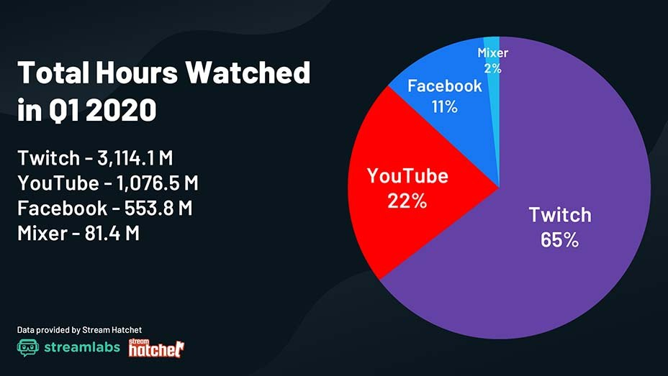
Live Video is Exploding

Slide 5
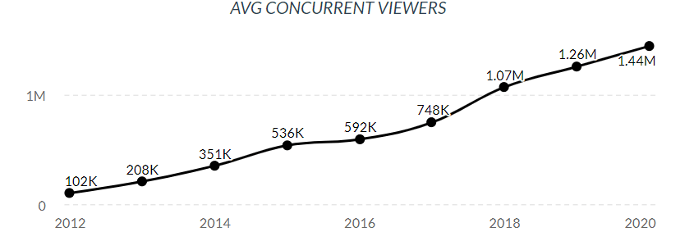
Twitch Audiences are Growing Fast

Slide 6
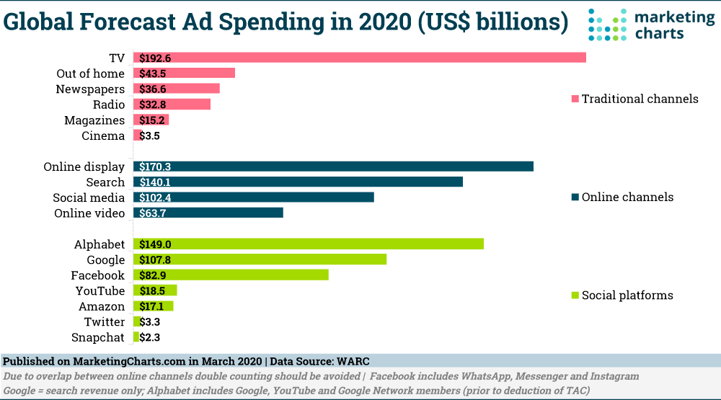
Quick Look: Online Video Ad Revenue

Slide 7
Entering the Gaming Industry

Slide 8

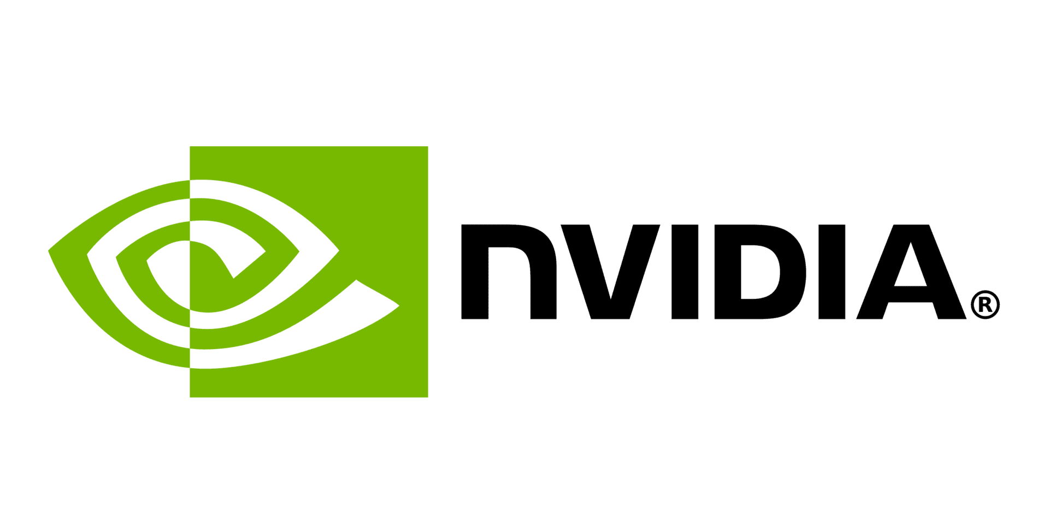

DataLucent’s Strategic Position
Thanks to a partnership with gaming audience engagement experts Muxy, gaming hardware manufacturer Zotac, and leading U.S. chipmaker Nvidia, DataLucent is strategically positioned to enter the gaming industry.
DataLucent has teamed with Muxy and Zotac to work with Nvidia and bring new data products to the gaming industry.

Slide 9
Muxy Brings Expertise
Muxy has been working in gaming since 2015 and has emerged as a leader on Twitch.tv.
They earned an Emmy for their innovative audience engagement solutions, as well as an Unreal Grant from Epic Games, creators of the Unreal Engine and Fortnite.
Muxy has collected data on Twitch users since their inception and has yet to monetize this asset.
DataLucent and Muxy are currently taking advantage of this strategic opportunity and building new experiences that incentivize streamers to evangelize our data collection software among Twitch users.

Slide 10
Zotac Wants Data
After speaking with 10 major players in the gaming hardware industry, Datalucent discovered that few hardware manufacturers utilize data for their marketing or sales.
Zotac has recently determined that data is important for their bottom line, and has agreed to work with DataLucent and Muxy to develop cutting edge data products geared for the gaming industry.
Zotac brought Nvidia to the table, and Nvidia agreed to fund incentives for our first gaming data acquisition and business insight development proof of concept.
Zotac is a subsidiary of a global IT solutions company, PC Partner, who will likely take an interest in this project and could provide additional revenue opportunities down the road.

Slide 11
Inroads to Nvidia
Nvidia surpassed Intel as the largest U.S. chipmaker last month. (July, 2020)
Nvidia has stated to Zotac that if this initial campaign is successful they would like to explore further opportunities in gaming, as well as opportunities outside of gaming.
Nvidia’s products can be found everywhere from smart TVs to self-driving cars such as Tesla. They are also a leader in machine learning hardware and cutting-edge datacenters.

Slide 12
Gaming Audience Data Acquisition

Slide 13
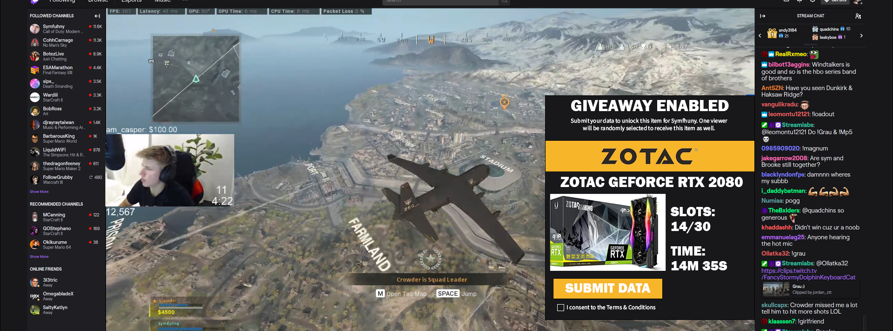
Twitch Extensions: Gateway to Gamers
Muxy’s expertise in Twitch development will be leveraged to produce a video overlay that engages audience members and solicits their consent for data.

Slide 14
The Funnel
Twitch Streamers
Twitch streamers solicit their viewers to consent to data collection from Twitch, as well as the right for DataLucent to contact them in the future with additional offers, via a Twitch extension.
Once a critical mass is established, those viewers are contacted via email and Twitch chat to consent to a second round of incentivized data acquisition via DataLucent’s data tool.
Twitch
Viewers
Data
Respondents

Slide 15
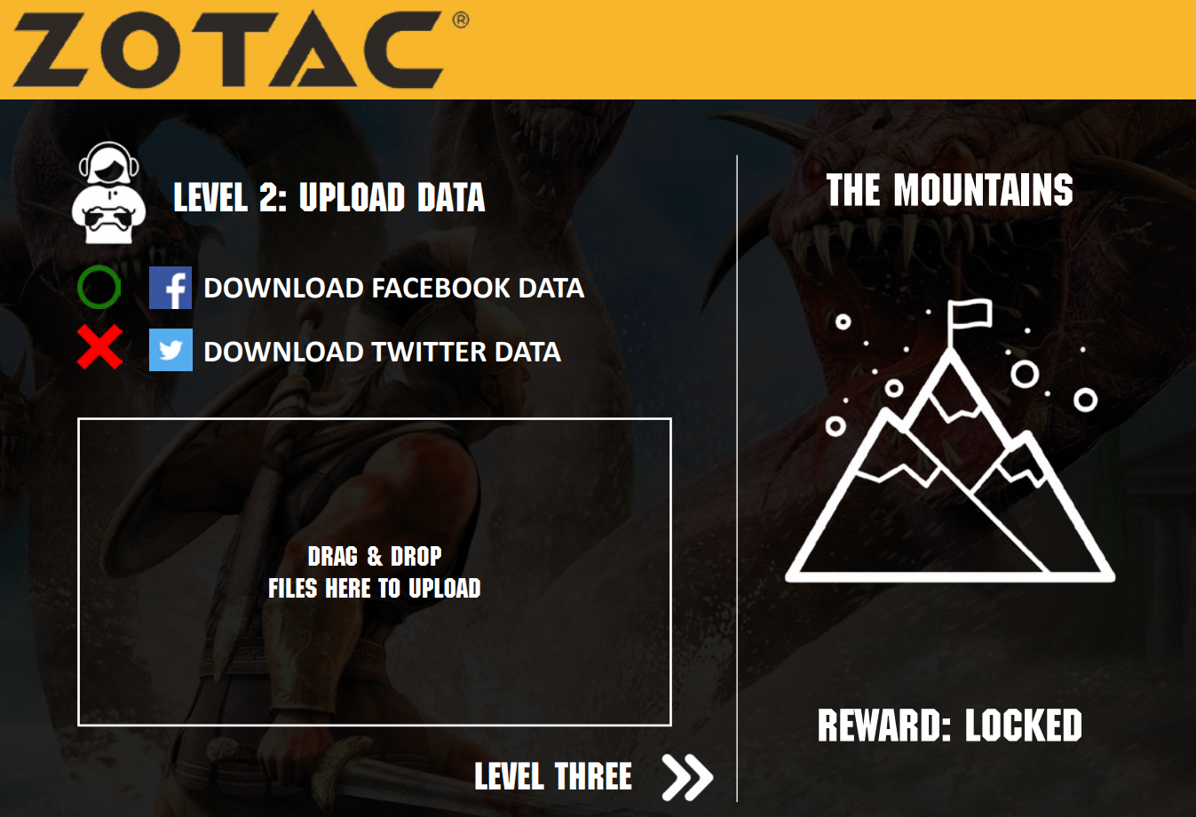
Acquiring Social Data
DataLucent software sits at the end of the funnel.
Zotac will assist in developing meaningful BI from our results.

Slide 16
Twitch + Social Media Data = Full Picture
Muxy’s existing reservoir of data on Twitch users and Twitch streamers is readily accessible after consent is given through the Twitch extension (video overlay).
After users consent on Twitch, our system will reach out to them again with another offer to participate in further rewards for sharing their social media data.
These combined datasets are one-of-kind, and fully compliant with privacy laws. The richness and depth of this information is unparalleled in gaming, or any industry.

Slide 17
The Campaign
15 influencers with
3000+ avg. viewers per stream per month over two weeks gives exposure to 45k gamers or more during that period.
Influencers
For the purposes of this proof of concept, the goal of 5000 respondents has been set. A 33% conversion rate for sweepstakes was used as the baseline expectation for Twitch conversions, and 11.1% is the total estimated conversion rate from Influencers to Respondents. Real-world scenarios are likely to differ.
45K
viewers
Twitch Viewers
45k viewers per stream per month are solicited to submit their Twitch data. Given a 33% conversion rate…
33% conversion rate
15k users will submit their data, and be solicited for a second giveaway and directed to a DataLucent data collection app. Given a 33% conversion rate on this process…
Social Media Data Respondents
33% conversion rate
5,000 Total Respondents

Slide 18
Viewer Incentivization
Streamers need data for sponsorships.
By giving data to help their favorite streamers, viewers can be incentivized towards providing access to their Twitch information.
After the campaign is completed, streamers will receive access to the information collected from their audience.
This allows them to provide deeper analytics on their audiences to sponsors and improve their chances at earning additional sponsorships.
This can be gamified, and the type of data that the streamer receives could be expressed through the gamification.
Notes:
On the last point: an FPS gamer might receive data that is male and prefers FPS, thus creating a gun toting man for an avatar. On the other hand, an ASMR streamer that appeals broadly but skews towards women could be expressed as a female druid. Just spitballing here. These characters could potentially fight other characters, perhaps in an Ethereum style battle a la crypto kitties?

Slide 19
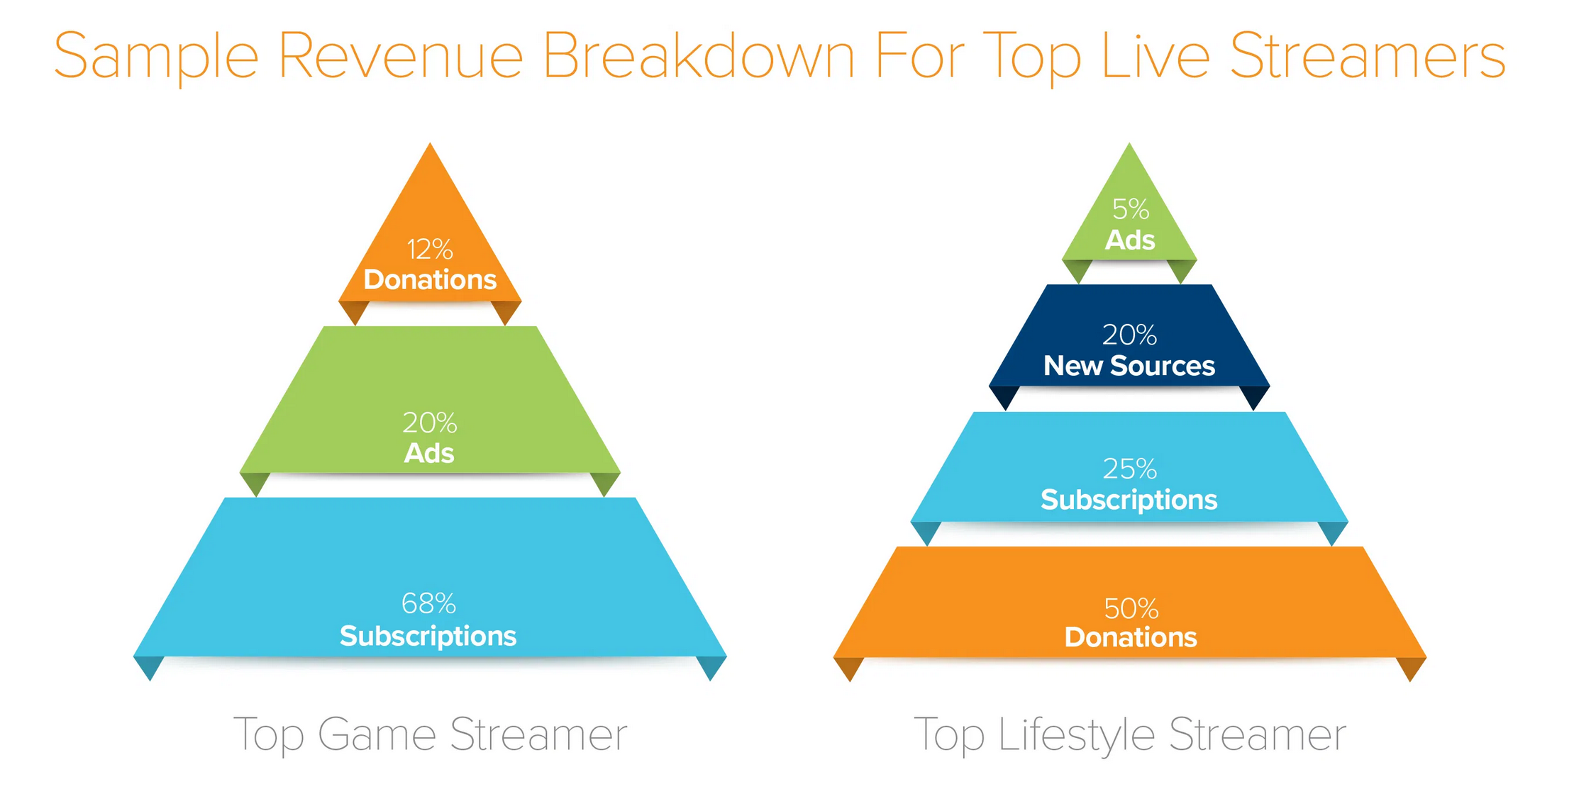
Influencer Incentivization
Streamers earn revenue from viewers in the form of subscriptions, ads, donations, and sponsorships.
This is a sample breakdown from a very successful streamer that earns $20k/month online.
Image source: Andreessen Horowitz.

Slide 20
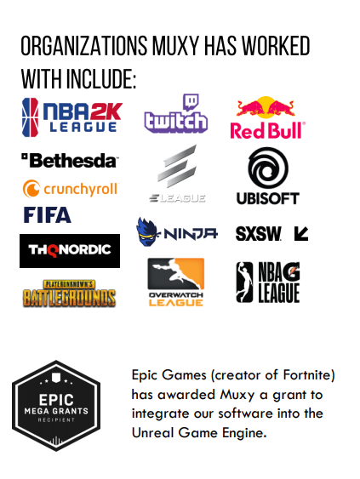
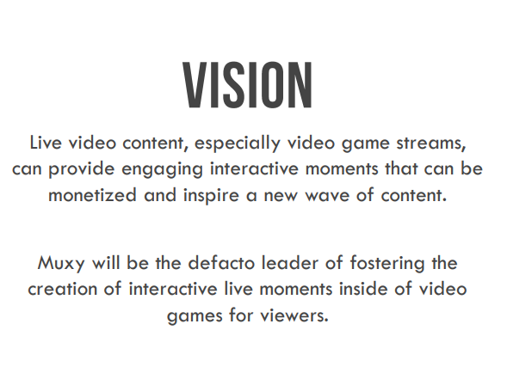

Slide 21
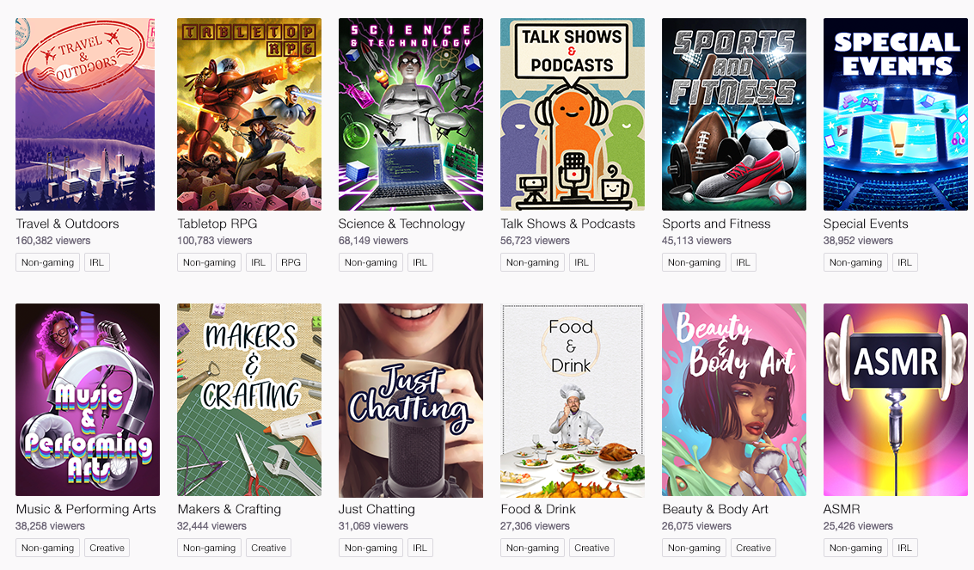
Twitch is More than Just Gaming

